Slide 1
Module 5: Measuring Success: Evaluating Environment and Health Change
Agency for Toxic Substances and Disease Registry (Created 2020)
Instructors: Laurel Berman, Leann Bing, Sue Casteel
Division of Community Health Investigations

Slide 3
Course Objectives
After finishing this module, you should be able to
Describe three general public health categories for which there are community-driven public health indicators associated with land reuse and redevelopment.
Describe at least three public health indicators that are associated with land reuse and redevelopment in each of three public health categories:
  Environment, Health, Economy
Access the Action Model to include community-driven public health indicators in redevelopment plans.
Explain the role, responsibilities, and scope of practice of a development community team member.

Slide 4
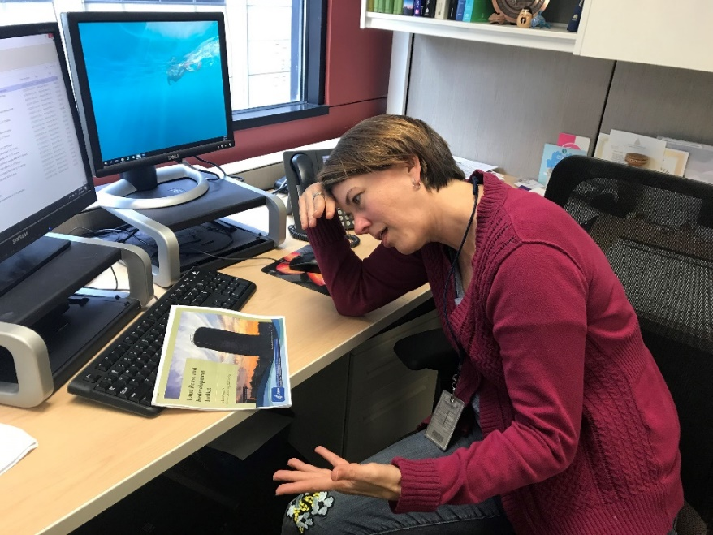
Course Details
Pre-test
Post-test: 70% or higher to receive a certificate
Create a 4-digit number to put on your pre- and post-tests
  Memorize the number or keep a written copy
  Use the same number on both the pre- and post-test
An environmental professional frustrated over taking a pre-test. ATSDR, 2019.

Slide 5
Pre-test
Pre-test Module 5
Put your 4-digit number on the top right corner of your pre-test

Slide 6
Measuring Change
Environmental or health professionals can measure changes that occur throughout land reuse/redevelopment
3 typical measurement categories
  Environment
  Health
  Economy

Slide 7
Why Measure Change?
Track changes in the physical and mental health (well being) of the community
Track changes in the environmental health of the community

Slide 8
Knowledge Check #1
Select the best answer:
The environmental or health professional can measure community changes in which three typical categories:
  Economy
  Health
  Gentrification
  Property availability
  Environment
  Community acceptance
Notes:
KC #1 ANSWER: a), b), and e). Economy, Health, Environment

Slide 9
Environmental, Health, and Economic Indicators
Definable
Are measurable
Have a data source
Example
Lead issues → Indicator is blood lead levels in children
  Is it definable? What?
  Is it measurable? How?
  What is the data source?
Notes:
Indicators can be used to track health outcomes (the broad view of health, from physical health to environmental health to economic health). Indicators should be measurable, have a definition, and have a source of data for measurement.

Slide 10
Example Indicators
Issue | Indicator
River pollution | Water quality data Fish consumption advisories
Lack of parks and/or green space | Number and types of vacant lots Number and use of green parcels Number of parks Number of bike lanes/trails
Vacant and contaminated properties | Inventory of sites Inventory of contaminants and associated health effects Map of sites
Habitat concerns | Wildfire survey Environmentally friendly lighting Habitat preservation
Notes:
These are indicators from an actual community development project to clean up land reuse sites along a riverfront

Slide 11
Knowledge Check #2
Select the best answers:
What indicators currently collected by communities can environmental or health professionals draw on to measure changes in environment ?
  Creation of a site inventory that incorporates a public health focus
  Pre- and post-redevelopment blood lead level data
  The number, size, and uses of green space
  The number of structures demolished and the number redeveloped
Notes:
KC #2 Answer: a), c), and d). Blood lead level data (answer b) would typically be a health indicator.
“Show of hands” for each bullet for each of the Knowledge Checks (KC), then have a discussion

Slide 12
Knowledge Check #3
Select the best answers:
What indicators currently collected by communities can environmental or health professionals draw on to measure changes in health (physical and mental health/well being)?
  Pre- and post-redevelopment blood lead level data
  The number, size, and uses of green space or recreational areas
  Crime statistics
  The number of structures demolished and the number redeveloped
Notes:
KC #3 Answer: a) and c). (blood lead levels are related to physical health and crime can affect mental health/well-being)
Show of hands…. Each bullet

Slide 13
Knowledge Check #4
Select the best answers:
What indicators can an environmental or health professional draw on that are currently collected by communities to measure changes in economy?
  The number, size, and uses of green space or recreational areas
  Crime statistics
  Property value of housing
  Demographic data on income, poverty, employment, and occupation
  Pre- and post-redevelopment blood lead level data
Notes:
KC#4 Answer: c) and d) are correct. These can show upward or downward economic change.
Show of hands … each bullet

Slide 14
Identifying Health Outcomes
The success of a project may depend on tracking and evaluating the community’s overall health:
  Physical health
  Mental health/community involvement
  Environmental improvement
  Built environment
  Economy
  Education
  Safety/Security
  Environmental resources
  Housing
Notes:
These categories are those selected by communities to develop indicators to measure changes in overall health status over the course of redevelopment.

Slide 15
Example of Identifying Health Outcomes
Community wants more access to healthy foods
Issue: We need more community gardens and grocery stores
Outcome: Increased access to healthy foods (with associated indicators to track, such as # of full service grocery stores, # of community gardens)
Notes:
Issues are related to community needs and concerns, e.g. a need for increased access to healthy foods.
Outcomes are a result of or change from addressing an issue, e.g. creating community gardens, or having new grocery stores in the community.

Slide 16
Outcomes: A Change or a Result
Lowered blood lead levels in children
Increased property values
New hospital with 10 new primary care providers
New grocery store with a full range of healthy food
10 sites demolished or redeveloped, lowering risk of exposure to lead, asbestos, volatile compounds, and petroleum
A new business opened and 20 jobs created for youth

Slide 17
Action Model Toolkit
Four steps of health-focused redevelopment
Step 4 creates community-driven public health indicators that can be tracked to measure changes in health outcomes
ATSDR has consolidated the indicators from 40 action models
  Refer to hand-outs at your table
Notes:
Let’s revisit our Action Model again. Step 4 generates community-selected indicators that can be tracked over time to measure changes in health outcomes.

Slide 18
ATSDR Community Health and Land Reuse Scorecard
You can fill in the Land Reuse Action Model Step 4 with indicators consolidated from 40 communities
Scorecard
  Collect or create indicators
  Paste into Action Model Step 4
Notes:
As part of the classroom exercise, these materials (Action Model Template and Indicator Scorecard) are printed at your tables.

Slide 19
Community Health and Land Reuse Indicators
Classroom exercise
Small groups
Review and use Land Reuse Action Model Template
Use indicator scorecard and indicator summaries
Notes:
Let’s divide up into groups (e.g. at your tables). Use the Action Model Template on your table from Module 4: Redesign with Health in Mind. You completed Steps 1-3. Or, you can start over and 1.) Come up with 3 or 4 issues you can name in your own communities (e.g. old buildings with suspected lead based paint and asbestos; or the need to reuse or demolish vacant structure, etc.). 2.) Decide on a redevelopment approach to address the issue (e.g., create an inventory of land reuse sites and include contamination concerns and condition of buildings that could be either demolished or reused depending on condition). 3.) Identify a health benefit of your action (e.g., prevent people from accessing dangerous buildings that might have dangerous contaminants and exposures). 4.) Select an indicator from the Indicator Summaries for each issue. You can write the indicators in both Step 4 of the Action Model Template and in the Indicator Scorecard.

Slide 20
Knowledge Check #5
Environmental or health professionals can use the Land Reuse Action Model Toolkit and indicator materials to help their communities select environment, health, economic, and other categories and indicators to incorporate in redevelopment plans.
True
False
Notes:
KC #5 Answer: a) True

Slide 21
Let’s Revisit: Asbestos Mine
Notes:
Let’s go back to our “mock” Asbestos Mine in Keweenaw Peninsula, MI.

Slide 22
Case Study: Asbestos Mine
The ABC site in Keweenaw Peninsula (mock)
  Active asbestos mine from early 1900s to 1993
  Chrysotile mined
  Tons of waste rock and mine tailings
Contaminated runoff from the mine tailings
  Surface water, stream, and sediment contamination
  Downstream wetland areas contaminated
    Source of airborne asbestos
    Recreational area for activities such as hiking on tailings piles.

Slide 23
Case Study: Recommendations and Messages for Regulatory and Health Agencies
Restrict access to the ABC Mine property
  Prohibit and discourage recreational use of site to minimize exposure
Prevent the removal and reuse of tailings and all other material beyond the ABC property
Don’t use wetlands located downstream for camping or other recreational activities.

Slide 24
Case Study: Asbestos Mine - Outcomes
Education and awareness campaign developed
  Federal, state, environmental and health agencies
Campaign informed residents about asbestos exposures and encouraged residents to minimize exposure by staying off the mine property
Site identified as a hazardous place where recreation can be dangerous to people’s health
Asbestos exposure prevented for160 people per year
Notes:
Let’s discuss each outcome. Do you think these outcomes are positive? Do you think people will be protected from exposure to asbestos?

Slide 25
Knowledge Check #6
Select all of the messaging actions that apply
Communicated findings and concerns to state and federal agency partners
With partners, encouraged residents to minimize exposure to asbestos by staying off the mine property
Allowed people to continue skiing or hiking on the sites as long as the snow was at least 3 inches deep
Prevented 160 people per year from being exposed to asbestos
Went hiking on the site with visitors to demonstrate that there was no risk of recreating on the site
Notes:
KC#6 Answers: a), b), and d).
Allowing people to continue using the site or hiking on the site with visitors (c)and e) are incorrect as these activities could expose people to asbestos.

Slide 26
Issues vs. Indicators vs. Outcomes
Issues are community concerns related to redevelopment
  E.g., contamination, contaminated site location, exposure concerns
Indicators can be derived to track progress towards achieving an improvement in health (the outcome) related to the issue
  E.g., list and location of contaminated sites, blood screening results
Outcomes are changes in health, environment, economy and many other public health categories
  E.g., increased access to healthy foods, lowered obesity rates, reduction in chemical exposures, increased property values
Notes:
Read each definition and example. Can you come up with additional examples?

Slide 27
Tabletop Exercise:
Issues, Indicators, and Outcomes
Play the “Name that Issue/Indicator/Outcome” game
Stay in your groups
On each table, there are decks of cards
Sort the cards into three piles: issues, indicators, or outcomes
Work together!
Notes:
This is a table-top game that has cards with Issues, Indicators, and Outcomes. (Cut out the squares prior to the class.) We use mock and de-identified information.

Slide 28
Post-test
Place your 4-digit number on the top of your test
You can retake the test multiple times
Test is open book
Passing score of 70% is required
Bring your test in tomorrow for grading

Slide 29
Thank you!
Laurel Berman, laberman@cdc.gov
Leann Bing, kbing@cdc.gov
Sue Casteel, scasteel@cdc.gov
Division of Community Health Investigations

